Slide 1

NGO
Fundraising
Ajaz Rashid
16th September 2025
Pitch Deck
Presented by
Date

Slide 2
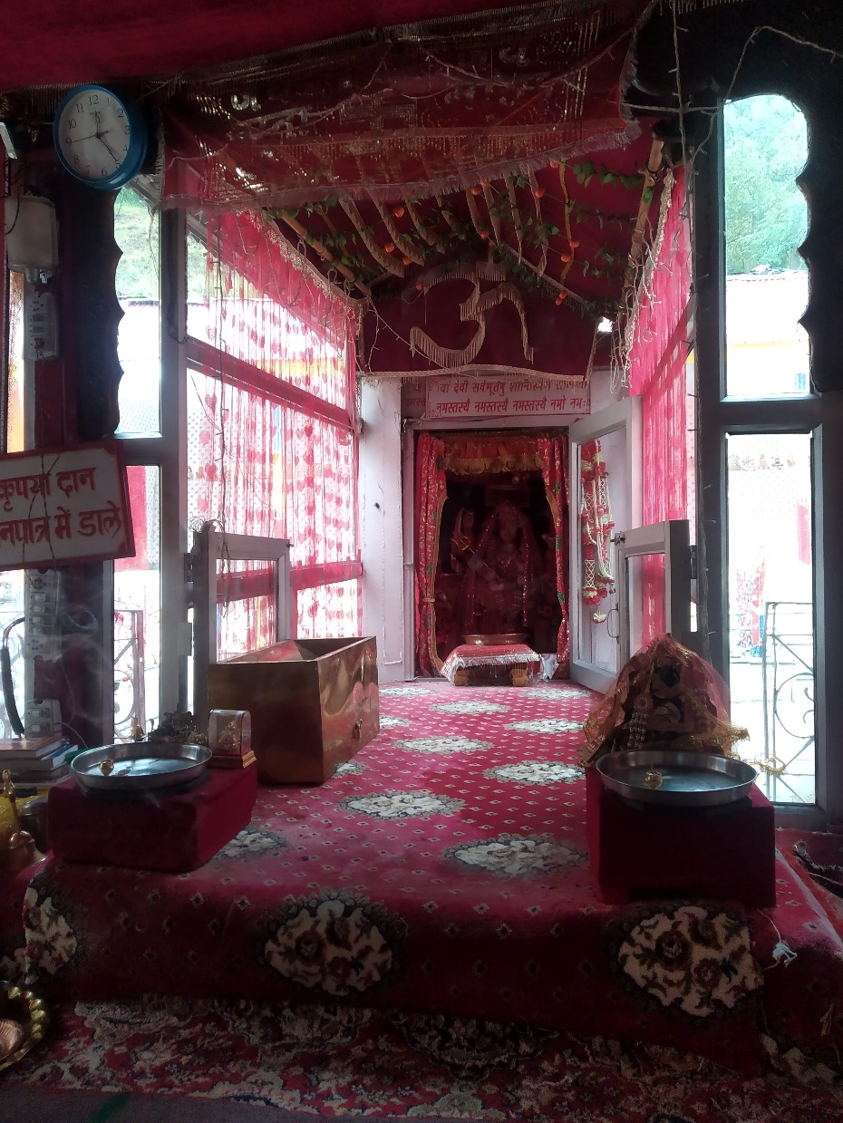
Who We Are
Achievements
200+
180+
150K+
We are a consultancy service for the nonprofit sector organizations committed to helping you fund your work, vision and mission.
NGOs guided over the last 35 years
Health Camps Programs
Children’ got education

Slide 3
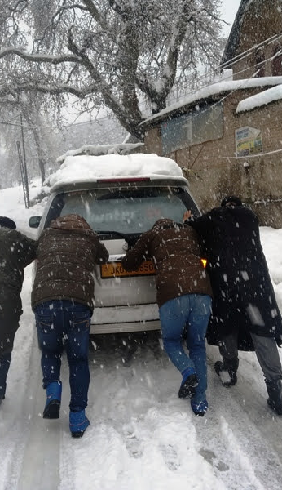
Our Approach
CSR
Donations
Grants
Creating CSR Projects for your NGO suitable to your geography, culture, themes, sectors, and organization. Let us join hand to make it HAPPEN.
For your healthcare services, including check-ups, vaccinations, and treatments, ensuring underserved communities receive timely medical attention and preventive care.
Identify, write, support and structure your grant applications with government, foundations, HNIs, others to develop a professional project deck suitable to each template.

Slide 4

How We Can Help You?
Donation
Community
Sponsorship
Volunteer
Support you get one-time or recurring donations
Help your monthly giving community
Help you Partner to get sponsor a Fundraising Camp
Create a volunteer network for your NGO

Slide 5
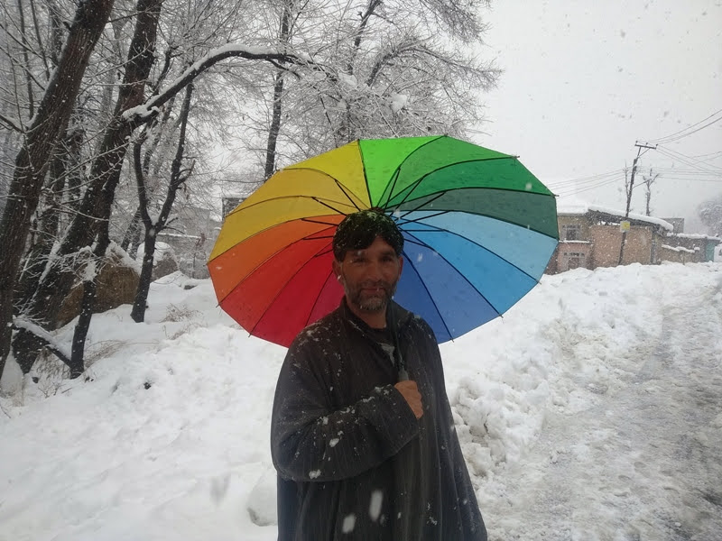
Partnership Opportunities
01
Corporates
02
Schools & Unversities
03
Foundations & Institutions
Awareness campaigns, youth ambassador programs
CSR programs, employee giving, co-branded projects
Multi-year grants for impact scaling

Slide 6
Future Vision
Goal:
01
02
03
Upcoming Projects
Expansion Plans
Sustainable Impact
Developing self-sustaining revenue stre`ams through social enterprises
Launch women-led health entrepreneurship program in rural India (2025)
Scaling up existing initiatives to serve more beneficiaries
Reach 1 million lives with safe education, water, and healthcare

Slide 7
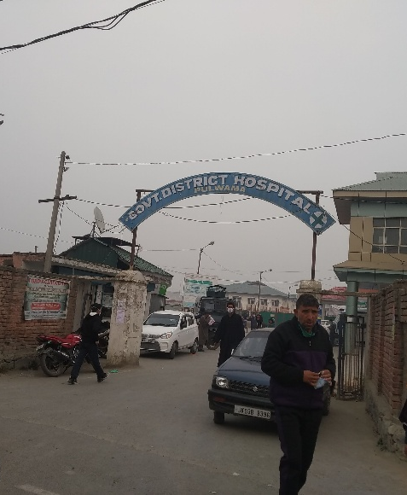

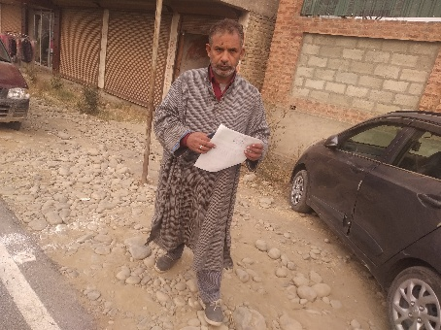
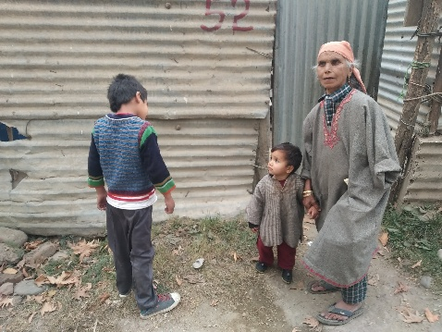
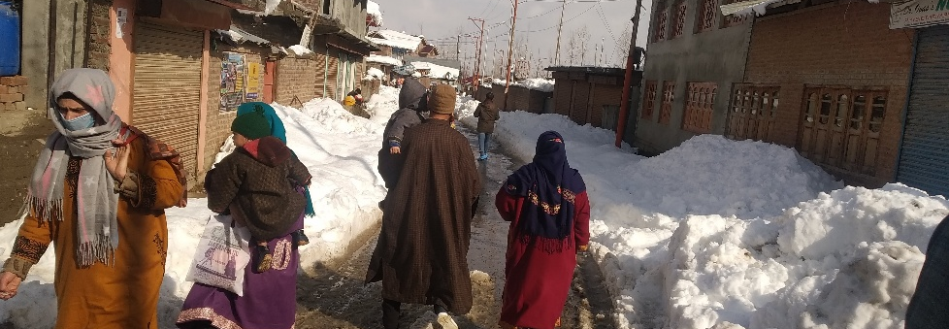
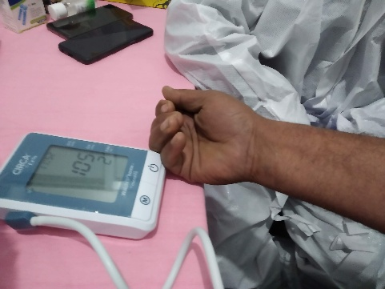
Our Gallery

Slide 8

“A child without education is like a bird without wings.”
– Tibetan Proverb

Slide 9
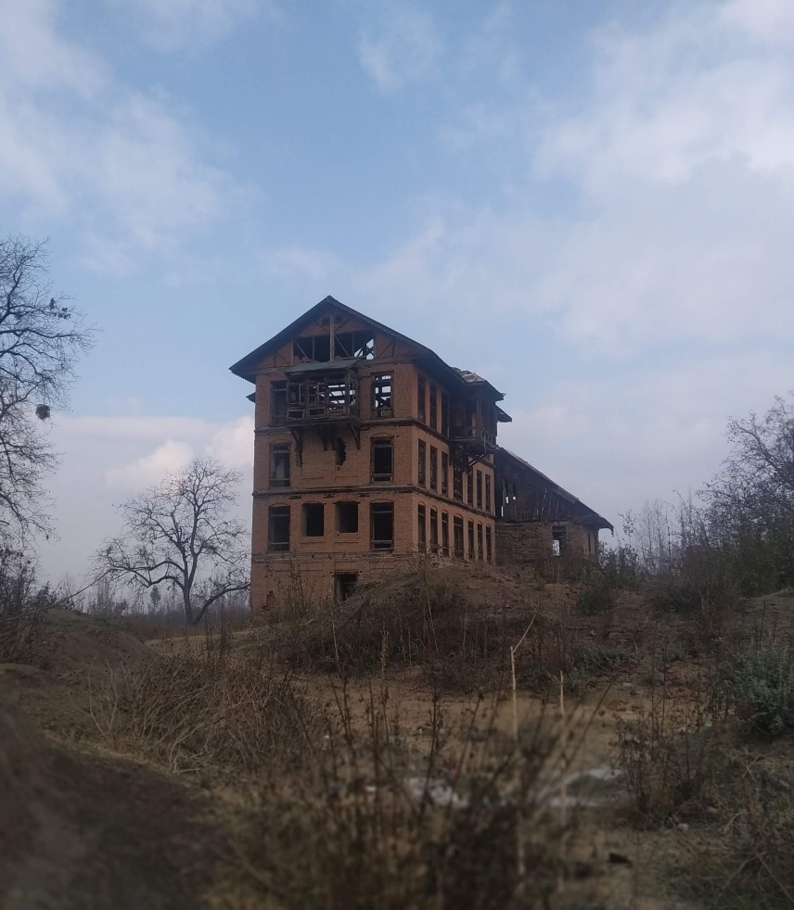


Join Us
Address:
Contact Us:
Donate Us:
Together, we can ensure that every NGO has access to funds and resources where they can thrive.
494/31 Faridabad Haryana - 121003
+91 (882) 504-3198
info@ajazrashid.org
www.ajazrashid.org

